Slide 1
HYPERMARKET MANAGEMENT SYSTEM

Slide 2
introduction
The Shop Management System is targeted to automate the almost all of the shop management processes to reduce the clerical labor of the staff working in Stores both technical and as well as Accounts departments using the software Industry’s latest technologies and cost effective tools there by providing the better control to the management by avoiding manual errors etc
Shop Management system is a simplified desktop system, that includes the functions of goods management, Goods management

Slide 3
PROBLEM STATEMENT
In the existing Store Management System departmental store management system, most of the work is completed manually by using paper records. It is a place where we get all our daily use basic requirement products. This is one of the difficult job to administrate. Most of these jobs are done manually. This includes many drawbacks
Increases the paper work
Time consuming
Loss of information
Security issues
Lack of integrated resources
Data duplication

Slide 4
FEATURES
Login for Manager, Employee
Manager can add a new product, edit change rate ,receive ,issues and display all list Products
employee management includes can edit receive and issues and display all list Products

Slide 5
ADVANTAGE
User friendly
Easy to modify the details
Less paper work
Human and manual work reduced
Automated reporting

Slide 6
REQUIREMENT

Slide 7
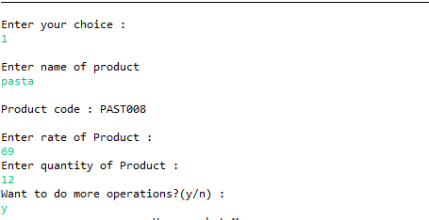
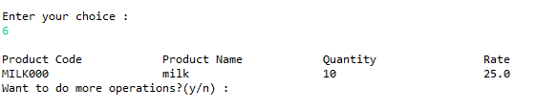
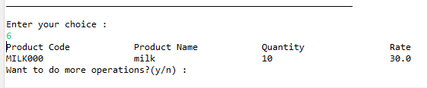
OUTPUT
Register New Product
Change Rate Of Product
Previous rate
New rate

Slide 8


output
Issue Product
Received Product
Previous quantity
Previous quantity
New quantity
New quantity

Slide 9
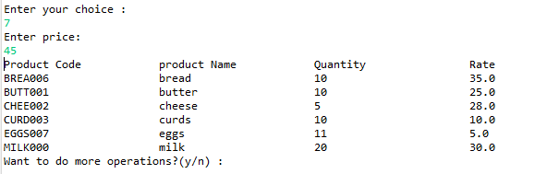
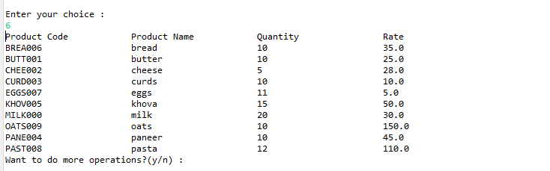
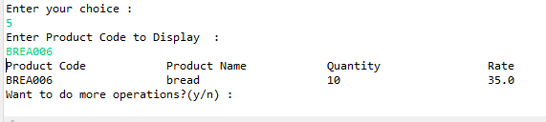
output
Display Product based on price
Display Product based on price
Product Details

